Slide 1
Kaiser Permanente Project
Design Sprint
Product Manager: Nélio Macombo
© 2019 Udacity. All rights reserved.

Slide 2
Set the stage
Set the stage for the Design Sprint by framing the problem
© 2019 Udacity. All rights reserved.
Notes:
[ALL PARTICIPATION]

Slide 3

Initial PRD
Kaiser Permanente PRD

Slide 4
Understand
Create a shared understanding of the space, problem, and goals
© 2019 Udacity. All rights reserved.
Notes:
[ALL PARTICIPATION]

Slide 5
How Might We Other Team Member Stickies
Kaiser Permanente is looking to enter into the preventative care space to help their patient base increase physical activity and improve on healthy habits. While the overall goal is improved patient satisfaction and well being, the specific financial goal is reduced cost by emphasizing improved health prior to any adverse conditions developing. Overall, KP wants to decrease spending on conditions such as type 2 diabetes.
Kaiser Permanente project scenario

Slide 6
How Might We - Other Team Member Stickies 01/03
How might we get people to drink more water?
How might we make health data easier for patients to understand?
How might we track a patient's physical activity?
How might we build good habits at a young age?
How might we make it easier to make healthy choices?
How might we help people make more healthy food choices?
How might we allow users to share health choices with friends?
How might we allow users to compare choices vs. norms?
How do we convince people to exercise regularly?
How do we teach patients how to mediate?
How might we facilitate conversations about health habits between patients and care providers?
How might we make it easier for patients to get exercise?
How might we notify patients when they are making a suboptimal food choice?
How might we help patients stop smoking?
How do we reduce a patient’s alcohol intake?
How might we reward healthy behavior choices?
How might we reward people when they learn about better health choices?
How might we connect people to health information?
How might we help a patient track their food choices?
How might we help people find accountability partners?

Slide 7
How Might We - Other Team Member Stickies 02/03
How might we reduce healthcare costs for healthy patients?
How might we provide better insights to doctors?
How might we help people manage their weight?
How might we help reduce high blood pressure?
How might we provider diet tracking?
How might we provide easier/quicker care to patients?
How might we get people to build healthier habits?
How might we gamify healthy habits?
How might we create a rewards system?
How might we help patients monitor their goals?
How might we help patients set health goals?
How might we allow people to better understand their health?
How might we make people aware of risk factors?
How might we identify and warn pre-diabetic patients
How might we prevent patients from making unhealthy choices?
How might we raise awareness across society?
How might we build a social support system?
How might we promote health habits?
How might we help people better understand diabetes?
How might we encourage people to drink more water?
How might we get people to walk 30 minutes every day?
How might we make people aware of their current state of health?

Slide 8
How Might We - Other Team Member Stickies 03/03
How might we reward patients for eating more vegetables?
How might we reduce sedentarism?
How might we incentivise exercise?
How might we identify healthy habits with the most benefit?
How might we gamify positive lifestyle changes?
How might we allow people to better track their own health data?
How might we create a personalized plan?
How might we warn users about unhealthy choices?
How might we make healthy food choices accessible?
How might we make healthy food choices affordable?
How might we encourage goals patients already are trying to make?
How might we use ubiquitous technology to improve patient health?
How might we make patients feel accountable?
How might we provide activity tracking?
How might we improve patient satisfaction and well being without increasing costs?
How might we educate our patients about healthy habits?
How might we help patients increase their physical activity?
How might we use ubiquitous technology to track patient data securely?
How might we reward patients for walking more?
How might we reward people for good behaviors?
How might we educate our patients about preventative health care?
How might we allow for safe and secure sharing of health data btw patient and caregiver.
How might we gamify health?
How might we.allow people to better access their medical records?

Slide 9
How Might We - Stickies
How might we help people with personalized plan?
How might we provide a report of our Physical Activity to doctors?
How might we help people with personalized exercise?
How might we help people track their reduce high blood pressure?
How do we gamify physical activity?
How might we warn users about sedentary behavior?
How might we help people manage their weight?
How do we simplify the development of an physical activity plan?
How might we connect people to health information?
How might we create a rewards system for physical exercise?
How might we help patients monitor their health and diet goals?
How might we recommend health goals to users based on their rotine?
How might we help people manage their weight?
How might we make fun the experience of loss or gain weight?
How might we create a personalized plan?
How might we prevent users from diabetic?
How might we connect with friends, family and doctors to share our phisical activity?
How might we provider phisical tracking mechanism?
How might we help users track their of eating diet ?
How might we build good habits regardless the age?
How might we help people better their health and physical situation?
How might we encourage people to exercise more on the daily basis?
How might we reward patients when their follow a healthier eating plan?

Slide 10
How Might We Clustering Stickies
Kaiser Permanente is looking to enter into the preventative care space to help their patient base increase physical activity and improve on healthy habits. While the overall goal is improved patient satisfaction and well being, the specific financial goal is reduced cost by emphasizing improved health prior to any adverse conditions developing. Overall, KP wants to decrease spending on conditions such as type 2 diabetes.
Kaiser Permanente project scenario

Slide 11
Improve Physical & Health Activity
How do we convince people to exercise regularly?
How might we make it easier for patients to get exercise?
How might we incentivise exercise?
How might we gamify Physical Activity?
How might we create a personalized plan?
How might we get people to build healthier habits?
How might we track a patient's physical activity?
How might we warn users about sedentary behavior?
How might we help people with personalized exercise?
How might we help people manage their weight?
How might we make patients feel accountable?
How do we reward people when they exercise regularly?
How might we get people to build healthier habits?
How might we use ubiquitous technology to track patient data securely?
How might we allow people to better track their own health data?
How might we help reduce high blood pressure?
How might we make users feel accountable with their Health Habits?
How might we help people organize their phisical plan ?
How might we reward patients for walking more?
How might we help patients stop smoking?
How might we educate our patients about preventative health care?
How might we allow people to better understand their health?
How might we help patients set health goals?
How might we help people sync their personalized exercise plan with their routine?
How might we gamify health?
How might we help patients increase their physical activity?
How might we reduce healthcare costs for healthy patients?
How might we provide activity tracking?
How might we help patients set health goals?
How might we build good habits at a young age?
How might we reduce sedentarism?
How might we make people aware of their current state of health?
How might we provide activity tracking?
How might we help patients increase their physical activity?

Slide 12
Improve Food & diet Habits
How might we notify patients when they are making a suboptimal food choice?
How might we allow users to share health choices with friends?
How might we help people make more healthy food choices?
How might we provide better insights to doctors?
How might we reward patients for eating more vegetables?
How might we promote health habits?
How might we provider diet tracking?
How might we make healthy food choices accessible?
How might we help patients develop a healthier eating plan?
How might we make healthy food choices affordable?
How might we make it easier to make healthy choices?
How might we connect people to health information?
How might we allow people to better track their own health data?
How might we reward patients when their follow a healthier eating plan?
How might we reward healthy behavior choices?
How might we reward people when they learn about better health choices?
How might we help users track their of eating diet ?
How might we gamify healthy habits?
How might we help a patient track their food choices?
How might we help patients stop smoking?
How might we identify healthy habits with the most benefit?

Slide 13
Satisfaction and Wellbeing
How do we teach patients how to mediate?
How might we reduce sedentarism?
How might we make health data easier for patients to understand?
How might we create a rewards system?
How might we improve patient satisfaction and well being without increasing costs?
How might we reward patients for eating more vegetables?
How might we build a social support system?
How might we help patients monitor their goals?
How might we gamify positive lifestyle changes?
How might we educate our patients about healthy habits?
How might we prevent patients from making unhealthy choices?
How might we reward people for good behaviors?
How might we allow for safe and secure sharing of health data btw patient and caregiver.
How might we help patients set health goals?
How might we.allow people to better access their medical records?
How might we make fun the experience of loss or gain weight?
How might we build good habits at a young age?
How might we allow people to better track their own health data?
How might we.allow people to better access their medical records?
How might we create a personalized plan?

Slide 14
Other
How might we get people to drink more water?
How might we facilitate conversations about health habits between patients and care providers?
How might we make health data easier for patients to understand?
How might we help patients monitor their goals?
How might we encourage goals patients already are trying to make?
How might we promote health habits?
How might we allow for safe and secure sharing of health data btw patient and caregiver.
How might we help people find accountability partners?
How might we gamify positive lifestyle changes?
How might we allow users to compare choices vs. norms?
How might we provide easier/quicker care to patients?
How might we create a rewards system?
How might we identify and warn pre-diabetic patients
How might we warn users about unhealthy choices?
How might we make people aware of risk factors?
How might we help patients stop smoking?
How might we raise awareness across society?
How might we prevent patients from making unhealthy choices?
How might we help people better understand diabetes?
How might we reward people for good behaviors?
How might we use ubiquitous technology to improve patient health?
How might we encourage people to drink more water?
How do we reduce a patient’s alcohol intake?
How might we build a social support system?
How might we get people to walk 30 minutes every day?

Slide 15
Sprint Focus
Focus | Improve Physical activity, Health activity & diet habits.
Slide # | Slide 11, Slide 12
I selected this theme because | I selected this theme to matches the following company goals: Improve patient physical activity, health food habits, satisfaction and wellbeing; Reduce the cost by emphasizing improvements on health habits prior to any adverse conditions developed by the body;

Slide 16
Define
With an understanding of the problem space, create focus and align on specific outcomes for the Design Sprint
© 2019 Udacity. All rights reserved.
Notes:
[ALL PARTICIPATION]

Slide 17
Success Metrics
 | Goals | Signals | Metrics
Happiness | Good physical shape; Healthier diet on the daily basis; | Perform App Reviews Answer Health Surveys | App Rating NPS Rating
Engagement | Exercise regularly Eat healthier food regularly | Sign-up on Workout and Nutrition; Time spend on YouTube Channels About Exercise/Workouts & Nutrition advise; | Avg. Session on Health Apps (Workouts, Tracking and Nutrition); Avg. Session on YouTube Health Subscribed Channels
Adoption | Download the app and subscribe to exercises Share the App with Friends | Refer the app to a Friend Download of the App | Referral sign-up rate # of Downloads
Retention | Subscription for Workouts Exercise Subscription for Nutrition Services | Recurrent payments Opt in to Subscription Tab | # of Monthly Subscribed Users Avg. Monthly Subscribed Users
Task Success | Find a good series of exercises Find a good combination of health food | Exercise added to wish list Items a added to diet plan | % of users with subscription active on monthly basis % of users with nutrition services subscribed

Slide 18
Healthier Guru – Your Personal Guru
“Healthier Guru is a digital accessible coach that makes you achieve your goals on an efficient way. This solution is for ordinary people, for achievers, from thin people who want to fight sedentary behaviors, from fat people who want to lose weight, from athletes who want to continue score better, build or maintain muscles, and improve their eating habits on a daily basis. Healthier Guru is a artificial intelligence personalized coaching / trainer and nutrition guru accessible everywhere, any time, any where as a mobile app that walk by with you and proactive advise or provide tips about how you can improve a little on daily basis and stand out on long term! Health is what matters, the rest are in no hurry "

Slide 19
Sketch
Generate tons of ideas, then narrow them down to two in depth solution sketches
© 2019 Udacity. All rights reserved.
Notes:
[ALL PARTICIPATION]

Slide 20
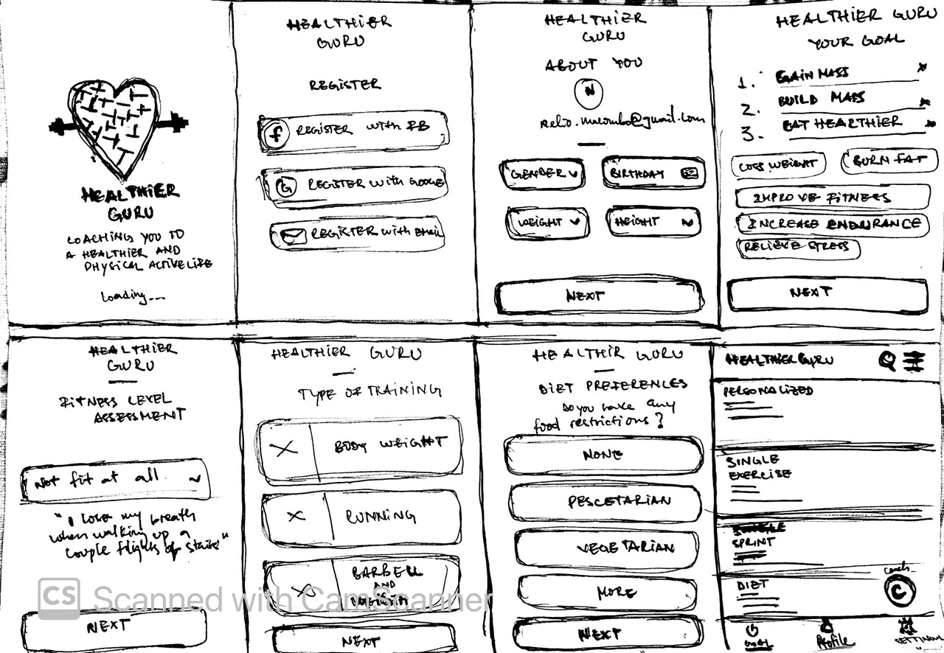
8 Sketches

Slide 21
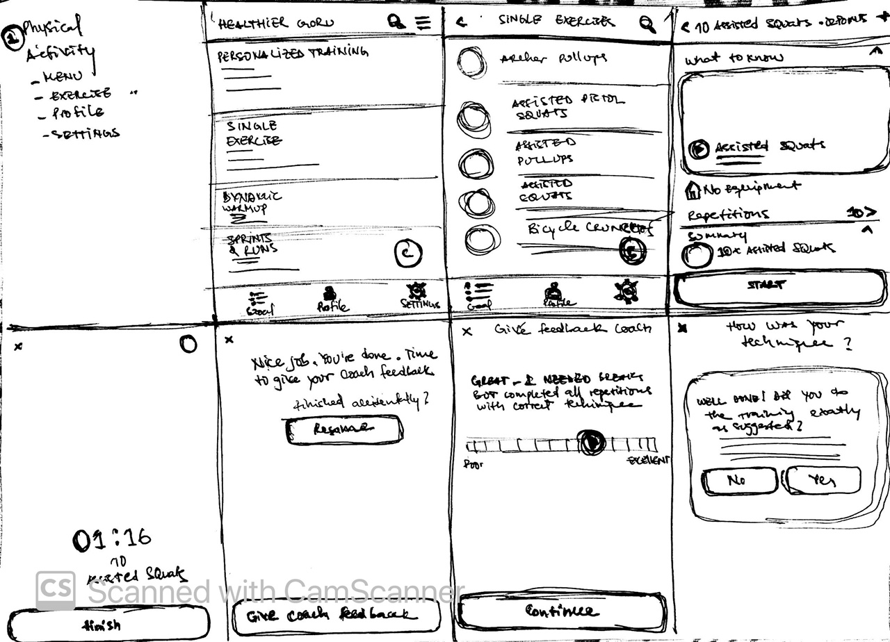
Solution Sketch 1
Main Menu
List of Exercises
Inside Exercise
Physical Activity
UIs Flow
Exercise Execution
Exercise End
Feedback UI 01
Feedback UI 02

Slide 22
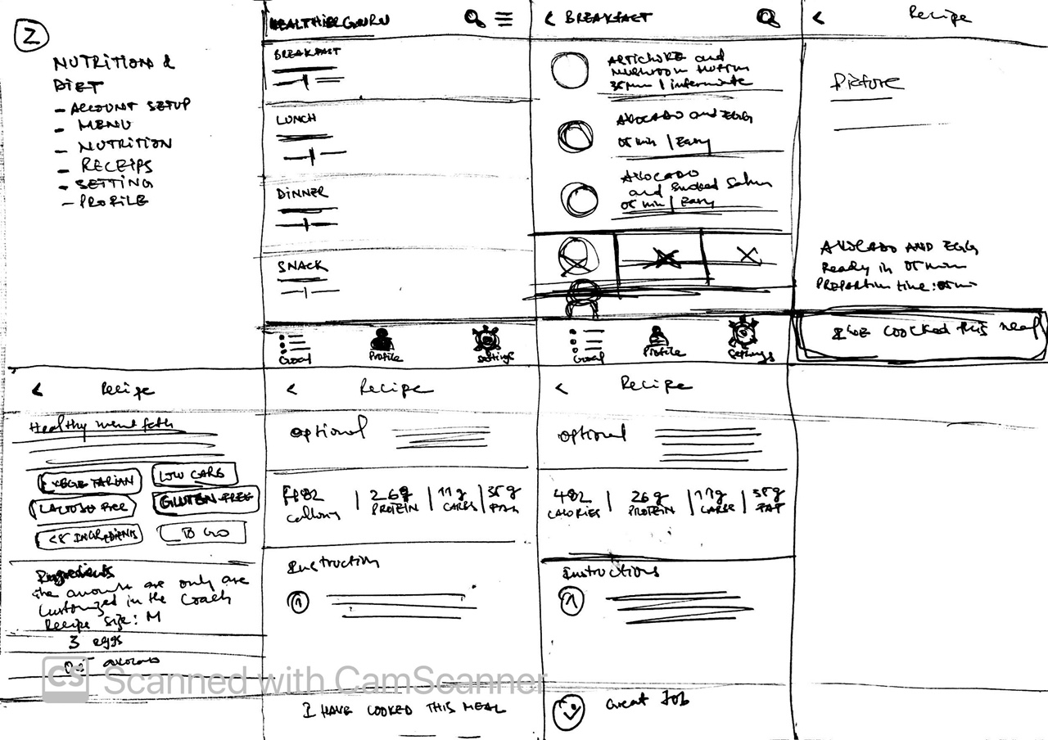
Solution Sketch 2
Main Menu
List of Receipts “Diet”
Inside Receipt UI - 01
Nutrition
UIs Flow
Inside Receipt UI - 02
Inside Receipt UI - 03
Inside Receipt UI - 04

Slide 23
Decide
Pick the final concept that you develop into a prototype
© 2019 Udacity. All rights reserved.
Notes:
[ALL PARTICIPATION]

Slide 24
Decision
Decision | Physical Activity - Solution Sketch 01
Rationale | I chose to explore more about this sketch to proactive solve the part of problem that consist on avoid or reduce deaths by changing physical behaviors, improving physical activity on a gamified way.

Slide 25
Prototype
Turn your concept into a realistic, interactive prototype that you will use to validate your assumptions and ideas
© 2019 Udacity. All rights reserved.
Notes:
[ALL PARTICIPATION]

Slide 26
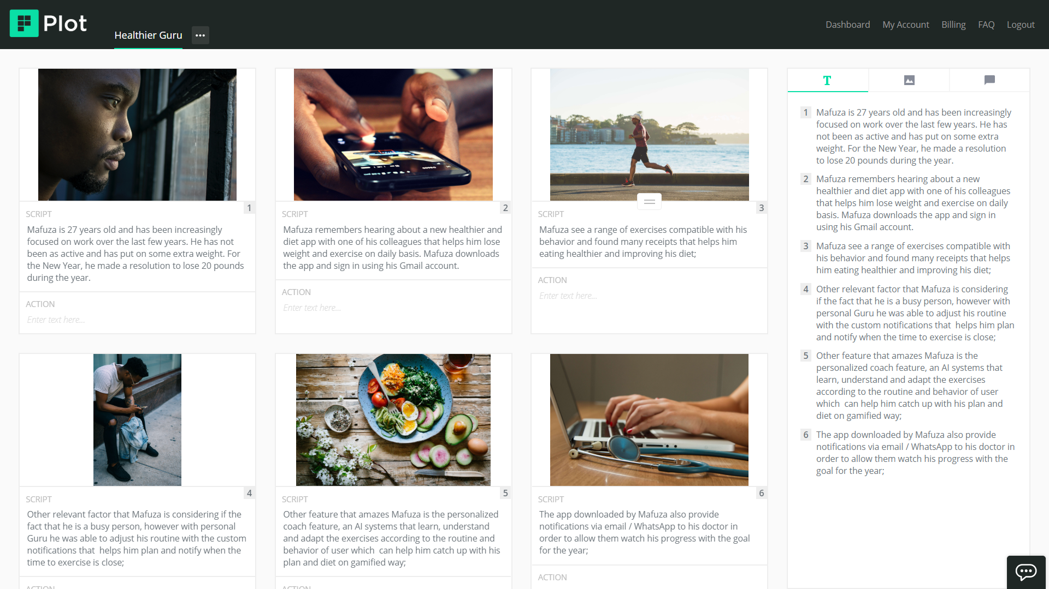

Storyboard 1/2

Slide 27
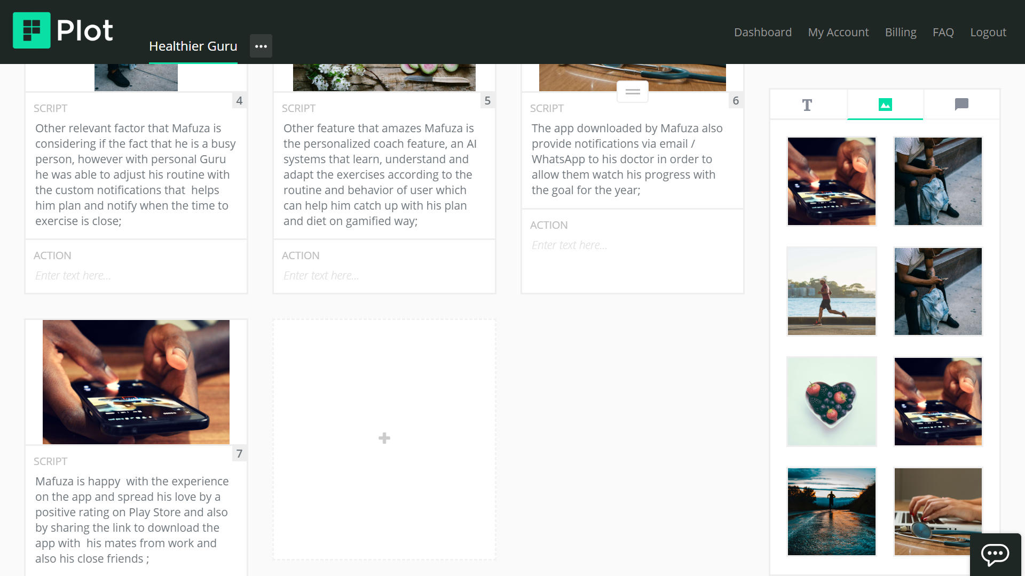
Storyboard 2/2

Slide 28
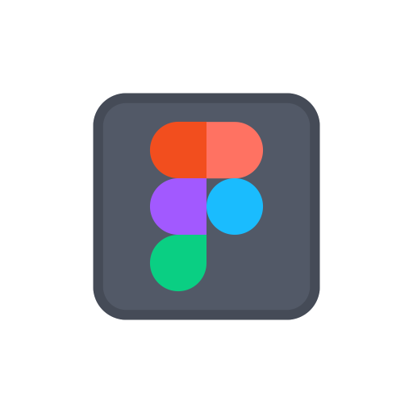
Prototype
Description High level overview of the prototype What does it do? | Healthier Guru prototype shows the flow from Setup an Account to perform Exercise
Assumptions Any assumptions within the prototype | Users will need to Sign In / Register to Access the Features Users can Set their Goals in order to have a personalized assistance;
Tasks What are the tasks that a user can complete in the prototype? | Create an account ; Define Goal (phisical or eating); View and execute exercises;
Prototype

Slide 29
Validate
Users will go through your prototype and provide feedback on your concept. This is also an opportunity to have an engineering feasibility discussion
© 2019 Udacity. All rights reserved.
Notes:
[ALL PARTICIPATION]

Slide 30
Plan and recruit for research
Research plan

Slide 31

User Testing
Notes
Audio recording
Key Findings from Participant 1
What worked well | The Participant understood the core features of the app; The Participant understood the objective of the Interview and provide a lot of useful recommendations & feedback; The Participant understood the setup of an account and how to perform an exercise;
Where participants got stuck | The Participant didn’t understood the “Diet Preferences” options, what they exactly mean and he advised to put comprehensible terms; The Participant didn’t understood the “Type of Training” user interface and feature assessment;
Other observations | The Participant described the different scenarios that we didn’t put on our prototype which is Gym or Workout with machinery and without it; The Participant suggested to put after level assessment, put small question to capture user goal, things such as “increase weight”, “lose weight”, and chose day of the week and time so the app can create a personalized plan; The Participant suggested reminders and accountability metrics based on the Goal;

Slide 32
User Testing
Notes
Audio recording
Key Findings from Participant 2
What worked well | The Participant understood the core features of the app; The Participant understood the objective of the Interview and provide a lot of useful recommendations & feedback;
Where participants got stuck | The Participant didn’t understood the basic setup of an account; The Participant got stuck on the Fitness Level Assessment;
Other observations | The Participant suggested to put an mentor that helps users achieve their goals by showing how far or close there are from their Goal; The Participant recommended that put the username on the corner of every relevant UI after the user Sign In; The Participant recommended to put the target on the Fitness Level Assessment in order to advise or notify the users how far or close their from their goals to exercise on the daily, weekly or monthly basis;

Slide 33
Improvements
Improvement #1 | Improve the account fitness level setup
Rationale | Improve Fitness Level Assessment UI and Flow in order to connect with user goal; Adjust the terms in order to be more understandable on the UI “Type of Training”
Improvement #2 | Insert a User Interface to Helps users create the personalized plan and push notifications of tips and daily reminders
Rationale | Users need to have their goal connected with a weekly plan that helps them understand if there are on track of far from the defined goals;

Slide 34
Feasibility
 | Your Assumptions | Specific feasibility questions
Drawing the UI What data is needed to draw the UI on the screen? Where is the data coming from | The basic data will be collected from the user on the setup account; Users can import data from apps such as Gmail, Facebook and Kaiser Permanente CRM Data; | Can we leverage that from any app installed on user cellphone? Can we connect the app with other reliable apps to get the sensible data such us weight, height and birthday in order to generate a proper personalized experience without errors ?
User generated data Is it stored? Where/how? How wll that data be used again? | The data of the exercises can be stored locally and them on midnight updated to cloud so we can have backups defied on daily or weekly basis by the user; | Which data can be stored locally ? Which data can be uploaded on cloud ? Which data we can keep using on recurrent manner ?
Latency How quickly should things load? Are there any operations that might slow down load time (ie: a call to another service)? | The exercise can be download when user setup their goal on account to perform smoothly; Download the videos of the exercise can slowdown a bit the app however while its downloading we can provide images that show the core tips; | Which development we should consider to have the data of the exercise ready to use ? Which platform we will be connecting to get data ?

Slide 35
Iterate
Leverage learnings from your first two user interviews to make changes to your prototype. Then run another round of user interviews.
© 2019 Udacity. All rights reserved.
Notes:
[ALL PARTICIPATION]

Slide 36
Prototype v2
Description High level overview of the prototype What does it do? | Healthier Guru is an app the helps users with physical exercises, from Home Workouts to Gym exercises and also provide them with tips and receipts to have a healthier diet.
Assumptions Any assumptions within the prototype | Healthier Guru helps you identify your fitness goal, define your weekly plan and helps you stick on track based on reminders and goal progress status report
Tasks What are the tasks that a user can complete in the prototype? | Setup an Account; Define a Goal (Physical Goal and Diet Goal); Define the weekly Plan (days of the week and hours for exercise);
Prototype v2

Slide 37
User Testing Round 2
Key Findings from Participant 3
Notes
Audio recording
What worked well | The participant feels that interface is clean; The participant feels that the components on the interface are understandable;
Where participants got stuck | The Participant didn’t understood about + option on Archer Pulls Up; The Participant doesn’t understand well the achievement of the goal;
Other observations | The participant suggested that user put other option on diet; The Participant suggested that have a tooltip that explain the recommended items, basically notes; The Participant suggested to show the previous selection of the user;

Slide 38
Handoff
© 2019 Udacity. All rights reserved.
Notes:
[ALL PARTICIPATION]

Slide 39
Updated PRD
Link PRD

